Slide 1
BLOCKCHAIN BASED SECURE BILLING FOR HOSPITALS
Group Members:-
Sourabh Vishnu Jamdade
Manish Prakash Jadhav
Ashish Hanmant Mahadik
Omkar Ganpat Sonawale

Slide 2
PROBLEM STATEMENT: Increasing number of fraud bills in this pandemic situation in hospitals
SOLUTION:
First things first, we have to make a system that cannot be altered once entered hence, making a centralized cryptographic based secure billing mechanism for each patient’s account using the blockchain technology

Slide 3
TECHNOLOGY USED:
Open source computer vision(OpenCV):
This technology is mainly used for image processing and getting price of the medicines from the image.
Blockchain:
This technology will be the core fundamental factor of our entire project, that will help us to maintain security constraints in the billing system using some cryptographic algorithm such as SHA256.
EasyOCR:
After taking an image of the price tag, the easyOCR (optical character recognition) will extract the text from an image.
Google Vision AI: (alternative for EasyOCR)
Google has developed a cloud based optical character recognition system back in 2015, which contains pre-trained models that works flawlessly and extract many properties from an image.
IP webcam:
The IP webcam is an app that is developed on android platform for connecting your phone’s camera over the internet. We will use this technology for capturing photos from phone that will bring good quality pictures along with the details.

Slide 4
Languages Used:- Python: since this language is comparatively light weight and having huge number of libraries that are directly dealing with the respective concept. And have capability to maintain memory very efficiently. While writing codes into modular format, the main issues comes when integrating all those modules into one while maintaining their dependencies. Python does this job very easily.

Slide 5
MODULES CONTAIN:
Image Capturing:-
This will be the very first module we will be making this module to capture the image of the respective medicine through webcam using OpenCV and IP webcam.
Image to String conversion:-
In this module, the above captured image will be stored and converted into test, to find out the MRP printed on it.
Google vision AI integration:-
If our hardcoded OCR failed to recognize the text from an image, the respected image will be push to the vision AI API for further OCR.
Hashing:-
The very important module is hashing. The acquired MRP price and the name of the name of the medicine will be given to this module to generate SHA256 hash for it, that will provide certain level of security.
Storing Information:-
At the end, whatever the hash was generated will be stored into the file along with the actual name and price of the medicine.

Slide 6
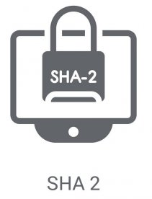
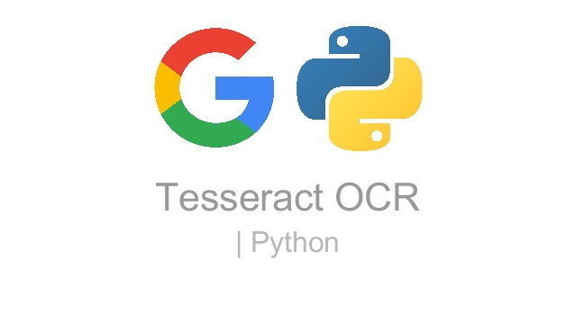





work flow:
Image capturing and processing
Optical character recognition for extracting text from an image
Building blocks of blockchain from given input data
Applying SHA256 on each item for making the chain more secure
Generating output
Alternative for easyOCR if failed.
Google cloud vision AI will extract the text

Slide 7
ADVANTAGES:
Will decrease the number of frauds happened in hospitals.
Provide 256 bit security to each item added into the patient’s account
SHA-256 is non-alterable, hence chances of altering the price of the medicine will reduce.
Patient will get the medicine at whatever its actual price.
No frauds will be happen when attaching the medical bill for gov servants.
Due to real time image capturing, hospitals can not enter overprices value into the system.

Slide 8
DISADVANTAGE:
Time consuming.
Will not captured price if outer package is damaged or MRP is scratched.

Slide 9
THANK YOU

